Slide 1
Mexico:
The People
Chapter 6, Sect. 3

Slide 2
Influences of the Past
Maya: Lived in Yucatan Peninsula between 250-900 ad
Built cities and temples in thick rain forests
Aztec: (the Mexica) lived in the area where Mexico City is located today.
Aztec were builders and traders, as well as fierce warriors.

Slide 3
The Spanish Heritage
1519: Army led by Cortes arrived in Mexico
1521: The Spanish had defeated the Aztec.
Mexico was a colony: Overseas territory, of Spain for almost 300 years.
Spain took advantage of the Native Americans, forcing them to work on farms and in mines.

Slide 4
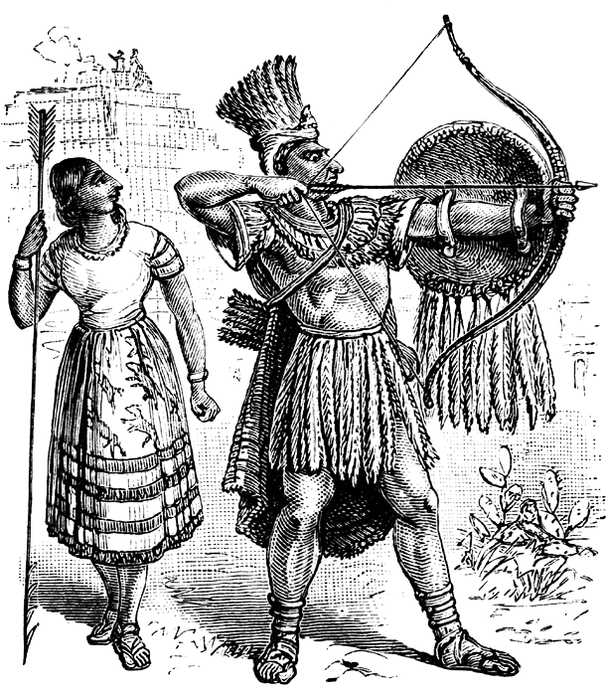

Slide 5
Spanish Heritage (cont.)
Result = Spanish & Native American cultures mixed.
Mestizo: Someone who is of mixed N.A & European heritage
Mexico Today: 60% Mestizo; 30% Native American
Religion: 90% of Mexico is Catholic, religion from Spain.

Slide 6
City vs. Country life
City Life:
Modern & Older Sections
Tall buildings in modern sect.
Not too crowded in homes.
Poor housing in older sect..
Can be crowded in homes.
Country Life:
Very poor lifestyle
Made of sheet metal, cement blocks, clay.
Main plaza has a church, couple shops, local gov.
Village has marketplace to trade, sell, buy goods.

Slide 7
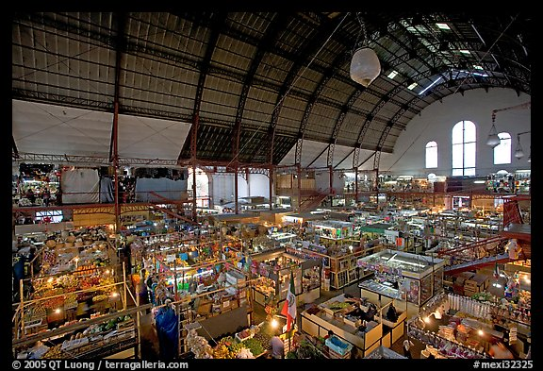

Slide 8
The Arts
Painters: Jose Clemente Orozco & Diego Rivera painted scenes from Mexico’s history.
Writers: Carlos Fuentes & Octavia Paz describe daily life
Music: Traditional Mexican Music is Mariachi with guitars, violins, horns, and bass.

Slide 9
Recreation
Celebrations: Mexico’s Independence Day (Sept. 15-16) and Cinco de Mayo (May 5) are Patriotic Fiesta days for Mexico. They also celebrate Christmas with different traditions:
Actors perform religious plays; after each play, children gather around a piñata and try to break it open blindfolded using a stick.
Foods: Traditional Mexican combines Native American and Spanish foods. Corn is essential to Mexican food.
Sports: Soccer (or fútbol) is the most popular sport. Baseball is also very popular, as is bullfighting.

Slide 10
