Slide 1
MEXICO
The Land

Slide 2
Vocabulary
BE SURE TO CIRCLE OR HIGHLIGHT THE
BOLD/UNDERLINED
WORDS THOUGHOUT
THE PRESENTATION
IN YOUR NOTES! ☺

Slide 3
Bridging Two Continents
Mexico forms part of a Land Bridge: Narrow Strip of land that joins two larger land masses.
Connects North and South America (still considered part of North America)
Off the West coast is Baja California (Norte y Sur)
Baja California = Peninsula: A piece of land surrounded by water on 3 sides.
West of Mexico = Pacific Ocean;
to East = Gulf of Mexico

Slide 4
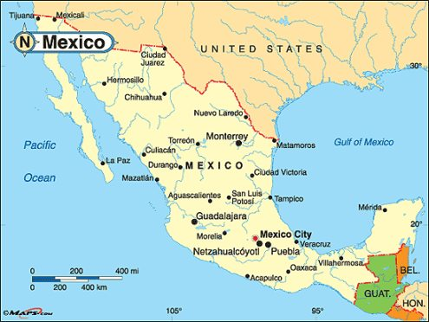

Slide 5
Land of Shaking Earth
Mexico sits on Rugged Territory- Why?
Mexico is the result of where tectonic plates have collided for centuries.
Result = Lots of Mountains, Volcanoes, & Earthquakes
Named “The Land of Shaking Earth” by the Aztec

Slide 6
Mountains & Plateaus
3 major mountain ranges:
  Sierra Madre Occidental, Sierra Madre Oriental,
  Sierra Madre del Sur
These mountain ranges surround a large flat center of the country = The Plateau of Mexico
Going south, the plateau rises with the occasional Basin: Broad, flat valleys.
Basins are surrounded by snowcapped mountains and volcanoes, which have left fertile soil in the basins.

Slide 7
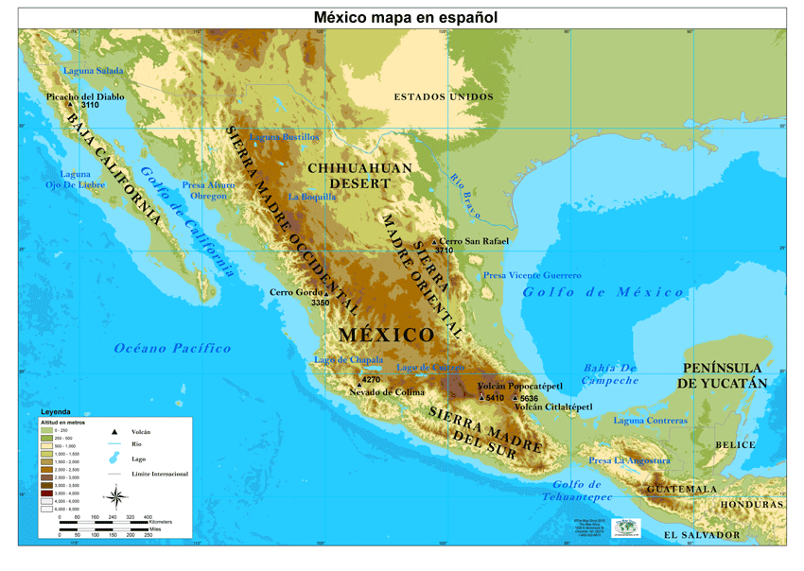

Slide 8
Coastal Lowlands
The coastal plains stretch along both the East and West coasts of Mexico.
Many of the country’s longest rivers flow through the coastal plains
The Rio Grande = empties into the Gulf of Mexico, and forms 1,300 miles of Mexico’s border with the United States.

Slide 9
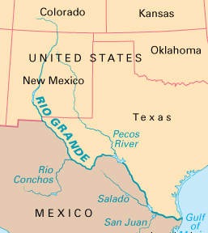

Slide 10
Climate
Mexico has a variety of Climates, just as the United States does.
Latitude: location N or S of the equator – Effects temperatures.
Mexico’s mountains also effect temperatures, creating it’s 3 Altitude Zones.
Altitude: height of the land above Sea Level.

Slide 11
Climate (cont.)
Look at the Altitude Map on pg. 157.
3 Altitude Zones are:
  Tierra Calliente or Hot Land = (0 ft. above sea level)
  Tierra Templada or Temperate Land = (starts @ 2,500 ft.)
  Tierra Fria or Cold Land = (starts @ 6,500 ft.)

Slide 12
Tierra Calliente
Hot and Humid all year round
Located in Costal Plains on each coast
77 degree average temp.
Has dense rain forests, tall grasses.
Excellent for growing bananas, rice, sugarcane, oranges, etc.

Slide 13
Tierra Templada
Up into lower mountain areas.
Located above the coastal plains, going toward the middle from each coast.
Cooler temps, around 70 degrees average.
Excellent climate for growing a variety of crops.

Slide 14
Tierra Fria
Located in the middle of the country, at top of the mountain ranges.
Much cooler temps, average at or below 68 degrees
Very little plant growth = short trees, small wildflowers.
Not good for growing crops.
Any higher, and you reach snow covered peaks.

Slide 15
Assignment
On a separate sheet of paper, choose one passage from this section and write a paragraph explaining something new you learned.
Be sure to use the Elephant Paragraph format:
  Introduction sentence
  Supporting information sentence
  Supporting information sentence
  Outside information sentence
  Concluding sentence

