Slide 1
The Early Greeks
Chapter 4, Section 1 (part 2)
(pgs. 116-123)

Slide 2
The Dark Age
By 1200 b.c. The Mycenaeans were in trouble...
Earthquakes and fighting between kingdoms had destroyed their palaces.
1100 b.c. the Mycenaean civilization collapsed.

Slide 3
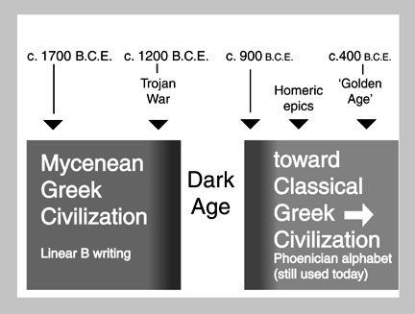

Slide 4
The Dark Age (cont.)
Between 1100 b.c. and 750 b.c.
  Overseas trade slowed
  Poverty spread
  Farmers grew only enough for their families
  Teaching of writing and craftwork stopped
Soon the Greeks had forgotten their old culture.

Slide 5
The (end of the) Dark Age
Dorians: Greek-speaking people who lived in the Northern Mountains- began to move south.
  Brought Iron weapons and farming tools with them
Farming increased creating a food surplus which revived trade.
With trade, new forms of writing became popular.

Slide 6
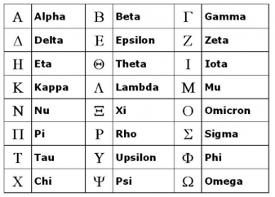

Slide 7
A Move to Colonize
After the Dark Age, Greek population boomed.
By 700 b.c. there was not enough food.
Cities began to send people outside Greece to start Colonies: a settlement in a new place that is ruled by the homeland.

Slide 8
A Move to Colonize (cont.)
Greece Colonies = Italy, France, Spain, North Africa, western Asia. These colonies spread Greek Culture.
Colonies traded heavily with Greece.
Greece began to use coins as money.
  Trade now goods for money rather than
  goods for other goods.

Slide 9
The Polis
City-States were known as a Polis: City and surrounding area run as an independent country.
The main area of each Polis was the Acropolis which sat atop a hill.
Below the acropolis was the Agora: which was a market//meeting place.

Slide 10
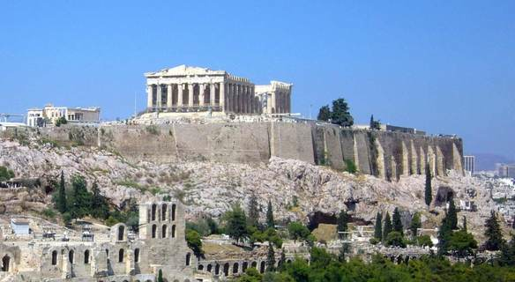

Slide 11
Greek Citizenship
Greeks were the 1st to develop the idea of citizenship.
Only native born landowners could be citizens.
Women could qualify but had limited rights that went along with it.

Slide 12
Greek Citizenship
Citizens could:
  Choose officials – Pass laws – Vote – hold office – own property – defend themselves in court.
In return, citizens had to serve in government and as soldiers.
Citizen soldiers were known as hoplites.

Slide 13
Assignment:
On a separate sheet of paper, choose one passage from this section and write a paragraph explaining something new you learned.
Be sure to use the Elephant Paragraph format:
  Introduction sentence
  Supporting information sentence
  Supporting information sentence
  Outside information sentence
  Concluding sentence

