Slide 1
The Early Greeks
Chapter 4, Section 1
(pgs. 116-123)

Slide 2
Vocabulary
BE SURE TO CIRCLE OR HIGHLIGHT THE
BOLD/UNDERLINED
WORDS THOUGHOUT
THE PRESENTATION
IN YOUR NOTES! ☺

Slide 3
The Geography of Greece
The geography of Greece influenced where people settled and what they did.

Slide 4
The Geography of Greece
Mainland Greece is a Peninsula, a body of land with water on 3 sides.
Use map on pg. 117 to locate
Greece & Peninsula
Ancient Greeks made a living using the sea-
  Fishers, Sailors, Traders

Slide 5
The Geography of Greece (cont.)
Greece has a lot of mountains & rocky soil
  Not good for farming major crops
  Were able to grow wheat, barley, grapes, olives
Also raised sheep & goats.

Slide 6
The Minoans
The Minoans were the first group to settle Ancient Greece. They earned their living by building ships and trading.

Slide 7
The Minoans
Crete: Island that lies Southeast of the Greek Mainland.
Crete was home to the Minoans who lived before the Greeks.
Minoans made their wealth from Trade
  Traded pottery & stone vases for ivory & metals

Slide 8
The Minoans (cont.)
About 1450 b.c.- Minoan Civilization collapsed suddenly.
Two possible reasons
  1. Undersea earthquakes caused giant waves that washed everything away
  2. Cities were destroyed by a group called Mycenaeans (My-suh-NEE-uhns)

Slide 9
The First Greek Kingdoms
Mycenaeans built the first Greek kingdoms and spread their power across the Mediterranean Region

Slide 10
The First Greek Kingdoms
(cont.)
Mycenaeans:
  Originally from Asia
  Invaded Greece in 1900 b.c. & took control.
  Mycenae leaders became the 1st Greek Kings
  Mycenae warriors became nobles .

Slide 11
The First Greek Kingdoms
(cont.)
Center of each Mycenae kingdom was a palace on a hill.
Inside Mycenaean palaces, people worked. They...
  Tanned leather; sewed clothes; made jars, swords, and shields, etc.
Outside the palace were farms.

Slide 12
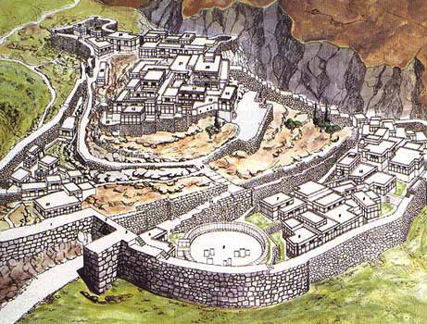

Slide 13
The First Greek Kingdoms (cont.)
The Minoans from Crete made contact with the Mycenaeans on the Greek Mainland.
The Mycenaeans learned and copied Minoan Culture
Soon the Mycenaeans replaced the Minoans as the region’s major power and possibly conquered and destroyed them.

